Slide 1
Dynamic data visualisation within the Tidyverse
Joshua Bird
Senior Policy/Analysis Officer

Slide 2
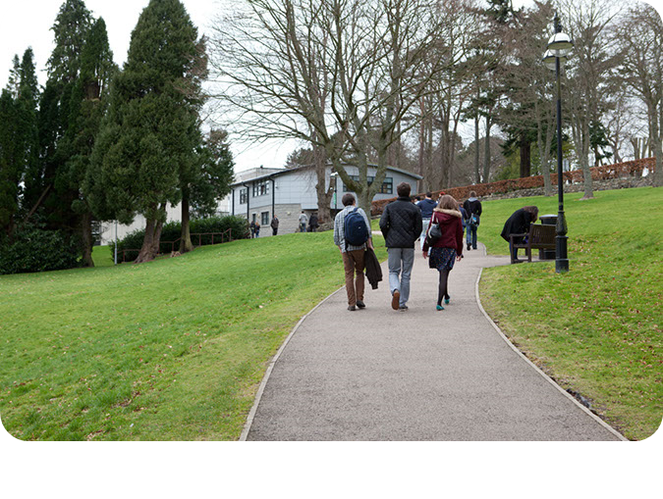
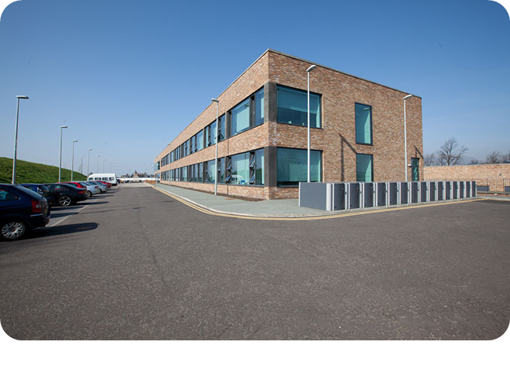
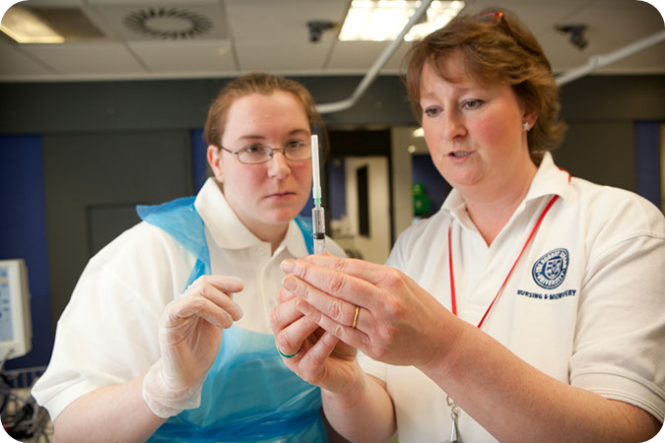
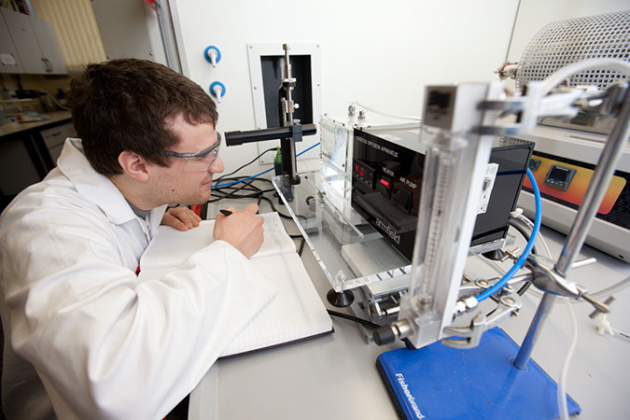
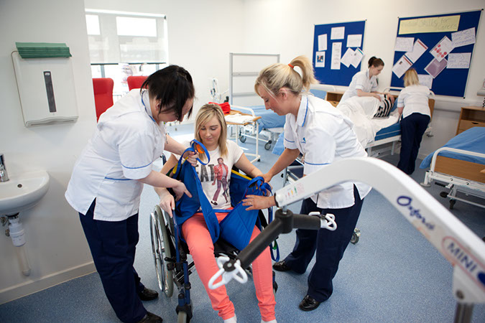

SFC allocates ~£2bn in public funds to Scotland’s 19 universities and 25 colleges each year for:
Skills development
Other costs such as staff, buildings and equipment
Widening access to further and higher education
Student support funds (for college students)
Learning and teaching
Research and innovation

Slide 3


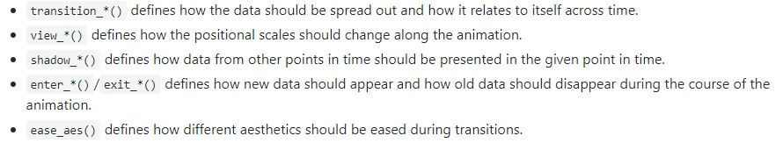
Telling data stories

Slide 4
Essential Concepts:
Packages:
Library(gganimate)
Library(transformr):
For manipulating the shapes of polygons and paths
Library(gifski)
GIF renderer
“Tweening”

Slide 5
Making a GIF
Four essential components:
ggplot2 code
gganimate grammar
animate()
gifski
anim_save()

Slide 6
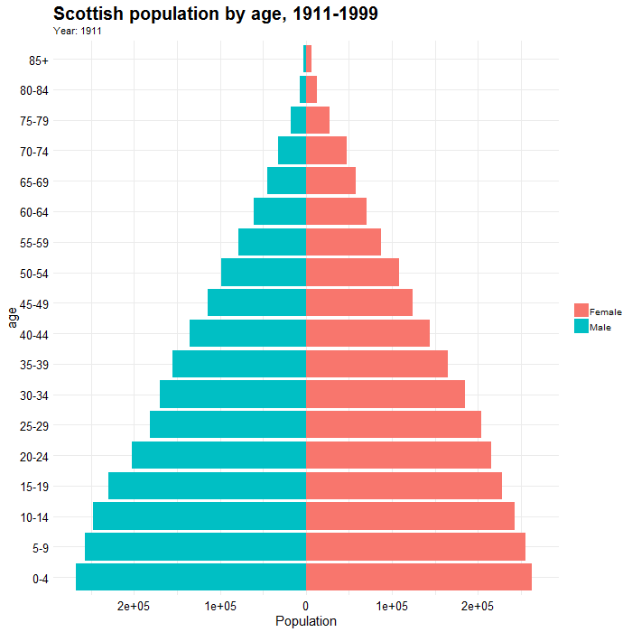
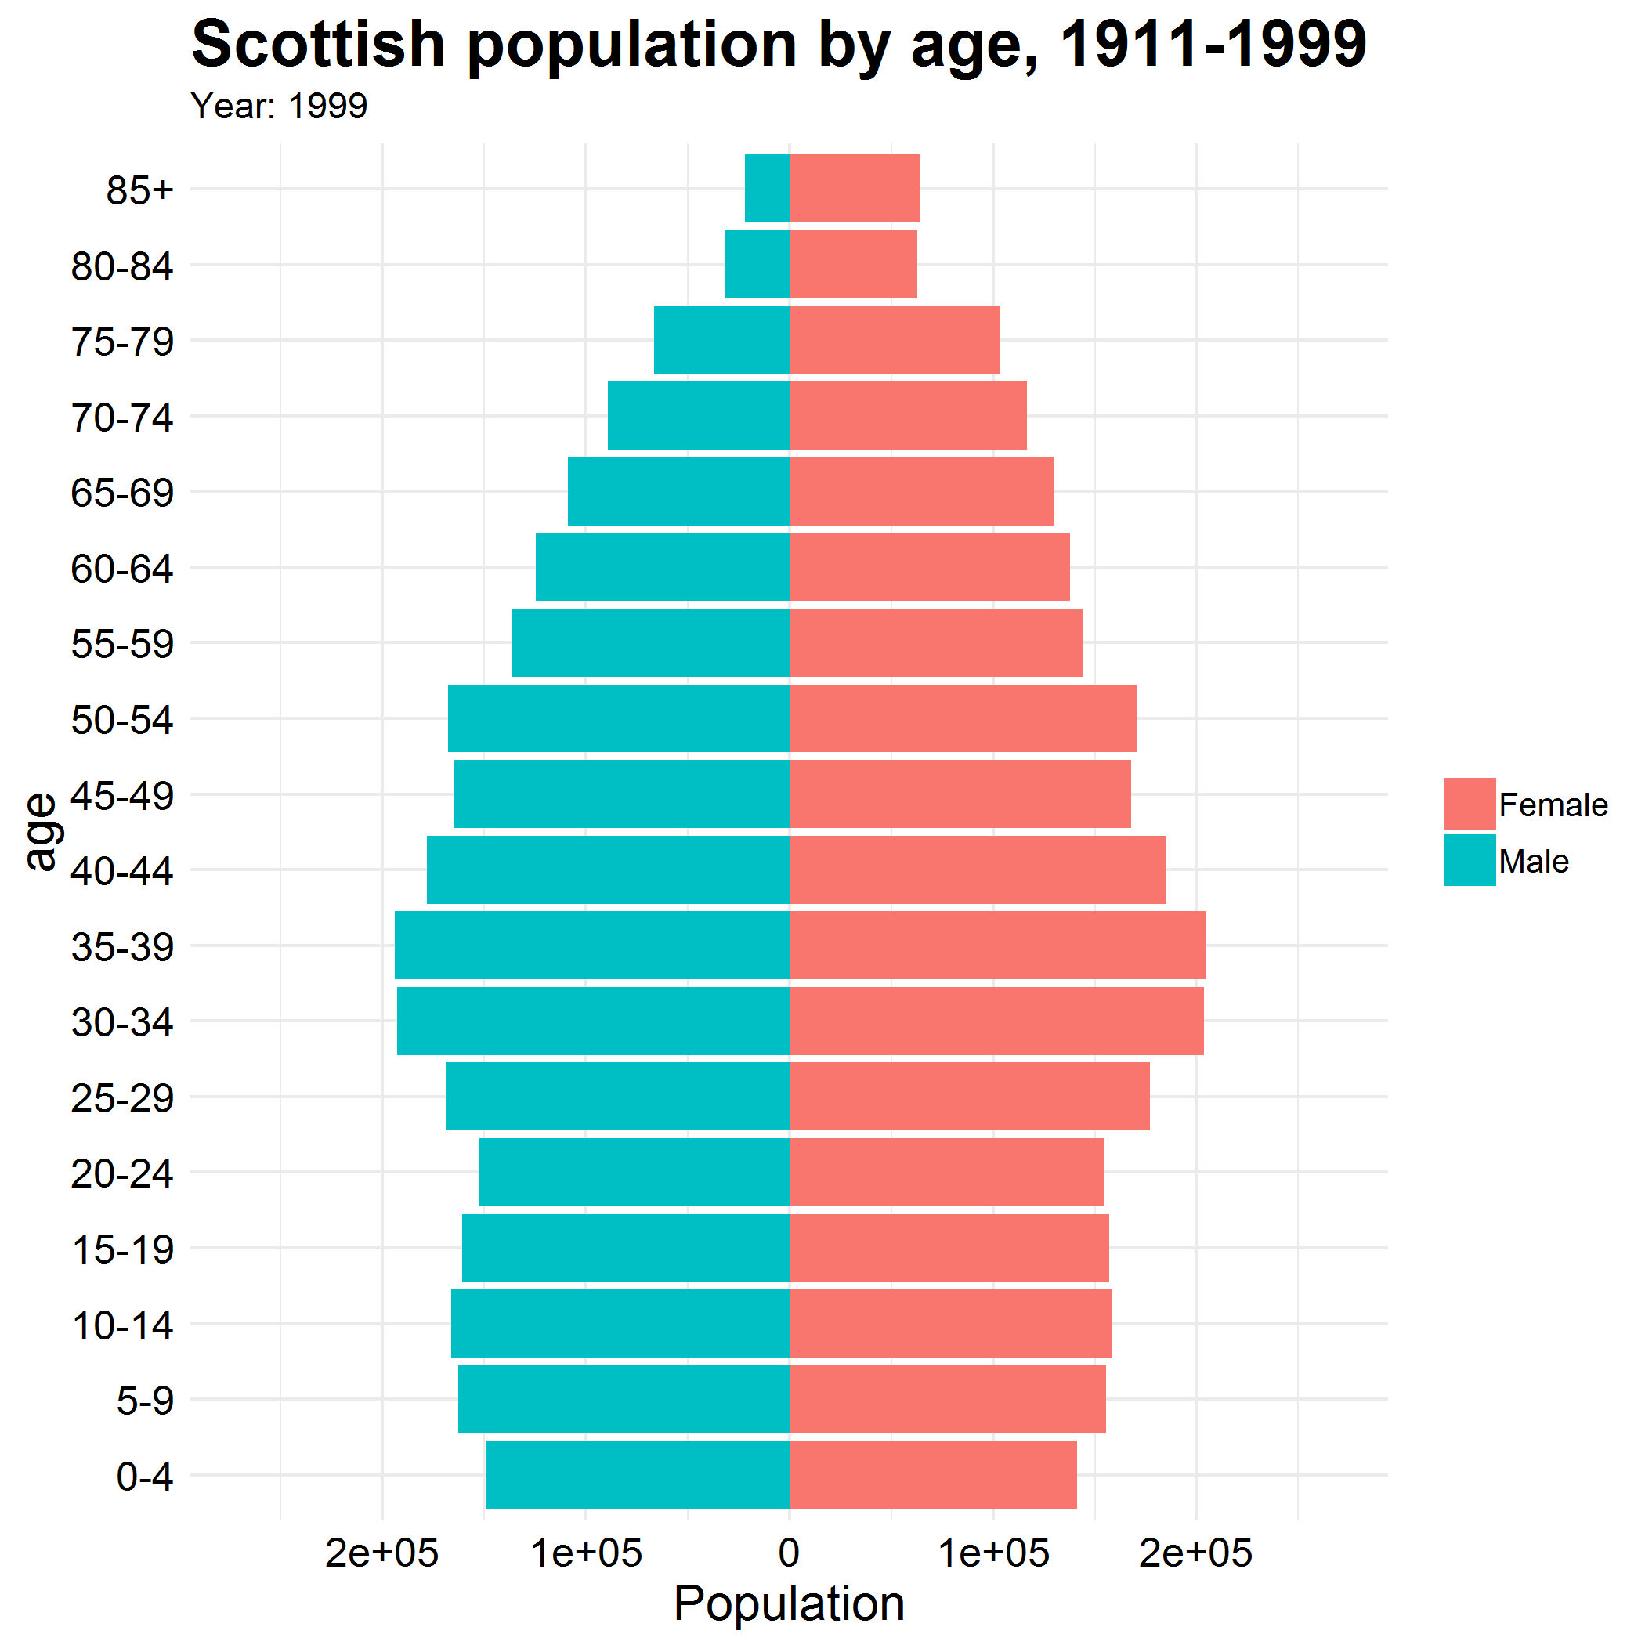
popgif2 <- popdata %>%
filter(Year >1910, Year <2000) %>%
ggplot(aes(x = age, fill = gender, y = ifelse(gender== "Male", yes = -total, no = total))) +
geom_bar(stat = "identity") +
scale_y_continuous(limits = max(popdata$total) * c(-1,1), labels=abs) +
coord_flip() +
theme_minimal() +
labs(y = "Population", title = 'Scottish population by age, 1911-1999', subtitle = 'Year: {frame_time}') +
transition_time(Year) +
ease_aes('linear')
animate(popgif2, end_pause = 10, width = 700, height = 700)
anim_save(filename = 'popfirst.gif')

Slide 7
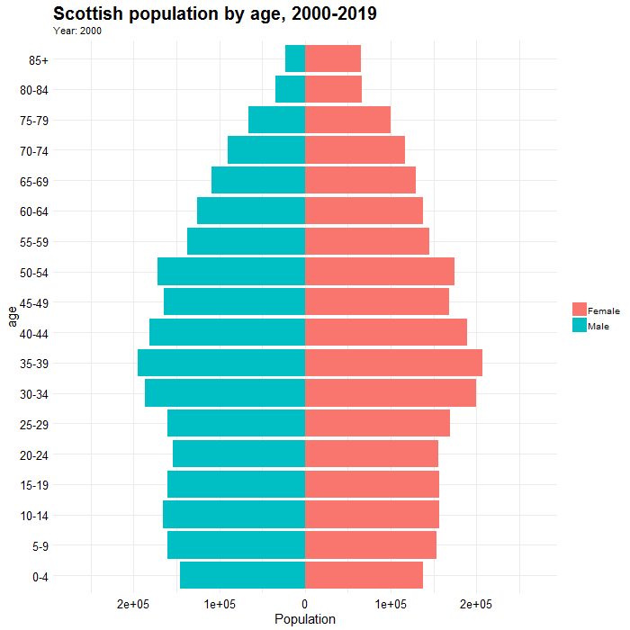
transition_time(Year) +
ease_aes(‘linear')
animate(popgif3, nframes = 200, fps = 20, duration = 10, end_pause = 10, width = 700, height = 700)

Slide 8
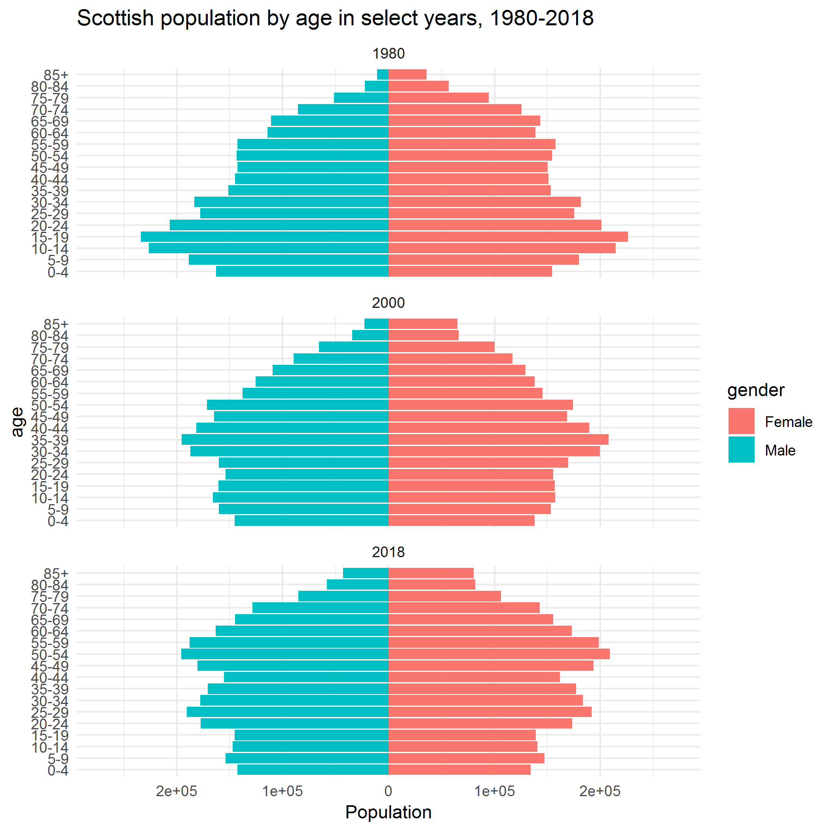

Slide 9
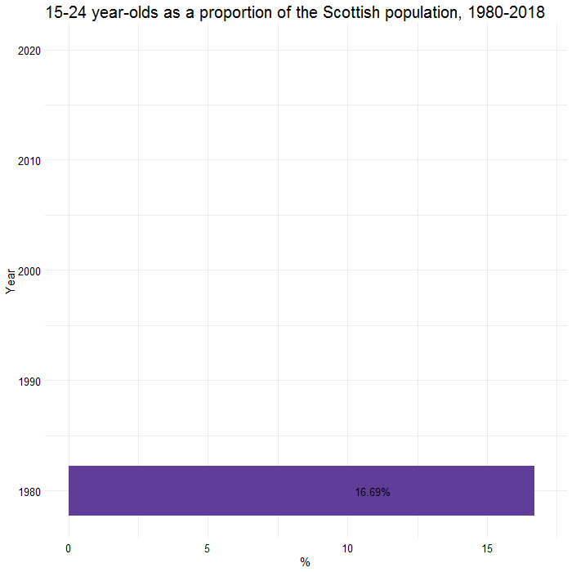
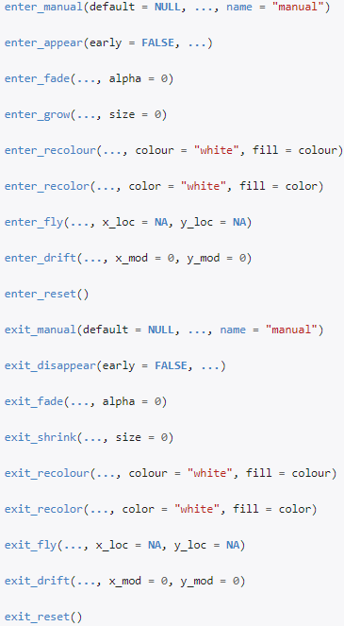
transition_states(Year, wrap = F) +
shadow_mark(colour = 'black') +
enter_grow()

Slide 10
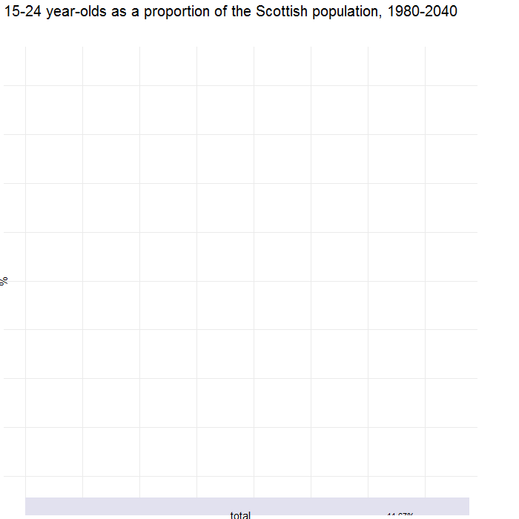
pop_select <- ggplot(data = popdata_final, aes(x=Year, y = total, fill = total)) +
geom_bar(stat="identity") +
labs(title = "15-24 year-olds as a proportion of the Scottish population, 1980-2040", x = "%") +
coord_flip() +
geom_text(aes(label = ifelse(Year %in% c(1980, 2018, 2040), paste0(total, '%'), "")), hjust = 3) +
scale_fill_distiller(palette = "Purples", direction = 1) +
theme_minimal() +
theme(plot.title = element_text(size = 20),
legend.position = "none",
axis.text = element_text(size = 12.5,
color = 'black'),
axis.title = element_text(size = 15),
strip.text = element_text(size = 15)) +
transition_states(transtate, transition_length = 2, state_length = 1, wrap = F) +
shadow_mark(colour = 'black') +
enter_grow() +
view_step(pause_length = 2, step_length = 1, nsteps = 2, wrap = F)

Slide 11
pop_select <- ggplot(data = popdata_final, aes(x=total, y = Year, fill = Year)) +
geom_bar(stat="identity") +
ggstance::geom_barh(stat="identity") +
labs(title = "15-24 year-olds as a proportion of the Scottish population, 1980-2040“, x= "%") +
coord_flip() +
geom_text(aes(label = ifelse(Year %in% c(1980, 2018, 2040), paste0(total, '%'), "")), hjust = 3) +
scale_fill_distiller(palette = "Purples", direction = -1) +
theme_minimal() +
theme(plot.title = element_text(size = 20),
legend.position = "none",
axis.text = element_text(size = 12.5, = 'black'),
axis.title = element_text(size = 15),
strip.text = element_text(size = 15)) +
transition_states(transtate, transition_length = 2, state_length = 1, wrap = F) +
shadow_mark(colour = 'black') +
enter_grow() +
view_step(pause_length = 2, step_length = 1, nsteps = 2, wrap = F)

Slide 12
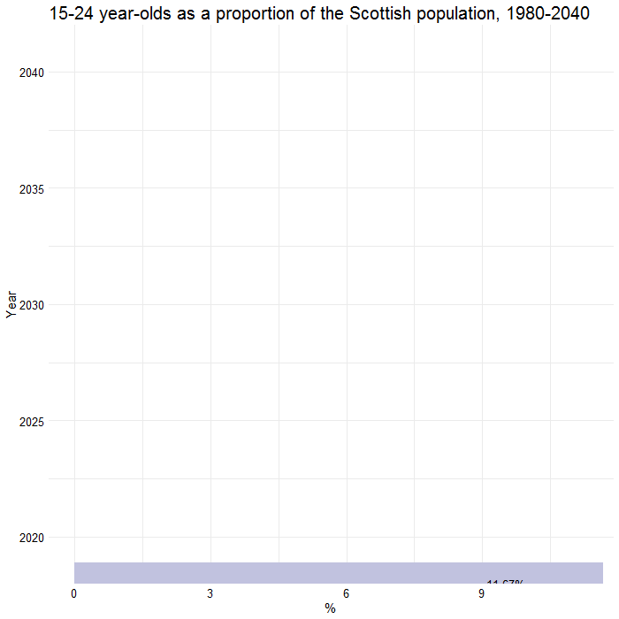
transition_states(transtate, transition_length = 2, state_length = 1, wrap = F) +
shadow_mark(colour = 'black') +
enter_grow() +
view_step(pause_length = 2, step_length = 1, nsteps = 2, wrap = F)
#DATA
#VIEW

Slide 13
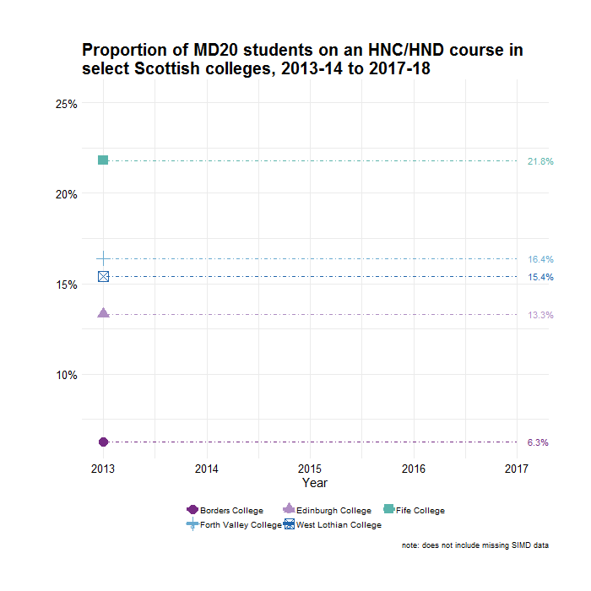
transition_reveal(year) +
ease_aes('cubic-in-out',
interval = .5)

Slide 14
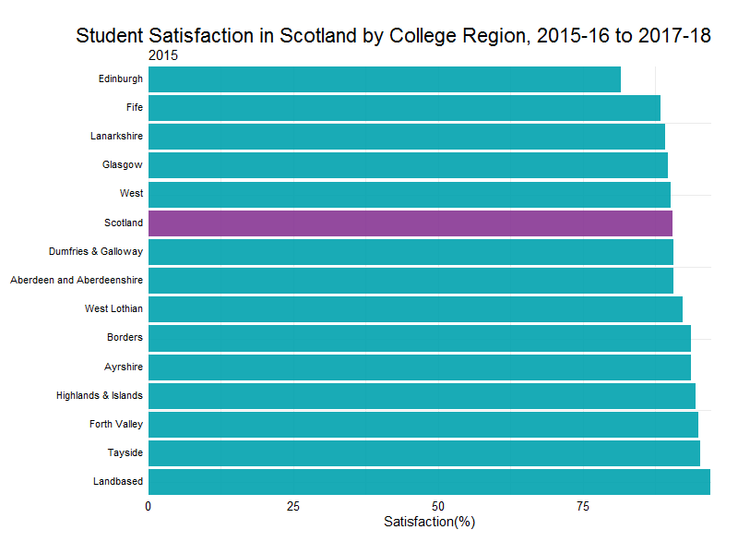
satisfaction_gif <- basedata_satisfaction %>%
ggplot(aes(x=ordering, y = satisfaction / 2, , group = region, fill = color)) +
geom_tile(aes(height = satisfaction, width = 0.9), alpha = .9) +
scale_fill_manual(values = c("#00A2AE", "#873694")) +
geom_text(aes(y=0, label = paste(region, " ")), vjust= 0.2, hjust=1) +
coord_flip(clip = "off", expand = FALSE) +
scale_x_reverse() +
theme(legend.position = "none",
plot.title = element_text(hjust = 1, size = 22),
axis.ticks.y = element_blank(),
axis.text.y = element_blank(),
axis.text = element_text(size = 12.5,
color = 'black'),
axis.title = element_text(size = 15),
strip.text = element_text(size = 15),
plot.margin = margin(1,1,1,5, "cm"),
plot.subtitle = element_text(size = 15)) +
labs(title = "Student Satisfaction in Scotland by College Region, 2015-16 to 2017-18",
y="Satisfaction(%)",
subtitle = '{closest_state}',
x = "") +
transition_states(year, transition_length = 2, state_length = 1) +
ease_aes('cubic-in-out')
basedata_satisfaction <- read.csv("satisfaction.csv") %>%
mutate(satisfaction = round(satisfaction * 100, digits = 2),
color = ifelse(region %in% "Scotland", "red", "blue")) %>%
group_by(year) %>%
mutate(ordering = min_rank(satisfaction)*1.0) %>%
ungroup()

Slide 15
Closing thoughts
Relatively new package
Surface level overview
Beware poor visualisations
Don’t forget the message!

Slide 16
